Slide 1
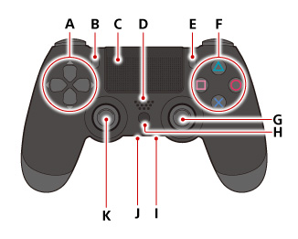
Sony Dualshock 4 Controller
A ) X, Y Directional buttons
B ) Park toolhead (SHARE)
C ) Toggle recording of move points (Touch pad) D ) not used (Speaker)
E ) Calibrate and goto home position (OPTIONS)
F ) Turn left/right and up/down
G ) Insert delay (R3) H ) Power on/off and connect Bluetooth (PS)
I ) not used (Stereo headset jack)
J ) not used (Extension port)
K ) Insert point (L3)

Slide 2
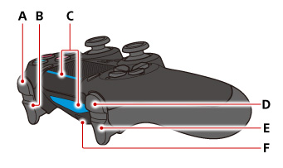
Sony Dualshock 4 Controller
A ) Turn gripper clockwise (R1)
B ) Close gripper (R2)
C ) Light bar: blue->Bluetooth connected D ) Turn gripper counter clockwise (L1)
E ) Open gripper (L2)
F ) USB port

Slide 3
Setup of Dualshock 4 Controller
Press PS button and wait for lightbar to turn on
Press Share and PS button and wait for blinking
Pair with a PC
Connect PS4 controller via USB to PC
Run the SixaxisPairTool and PS4 controller to ESP32 Bluetooth MAC address

